Slide 1


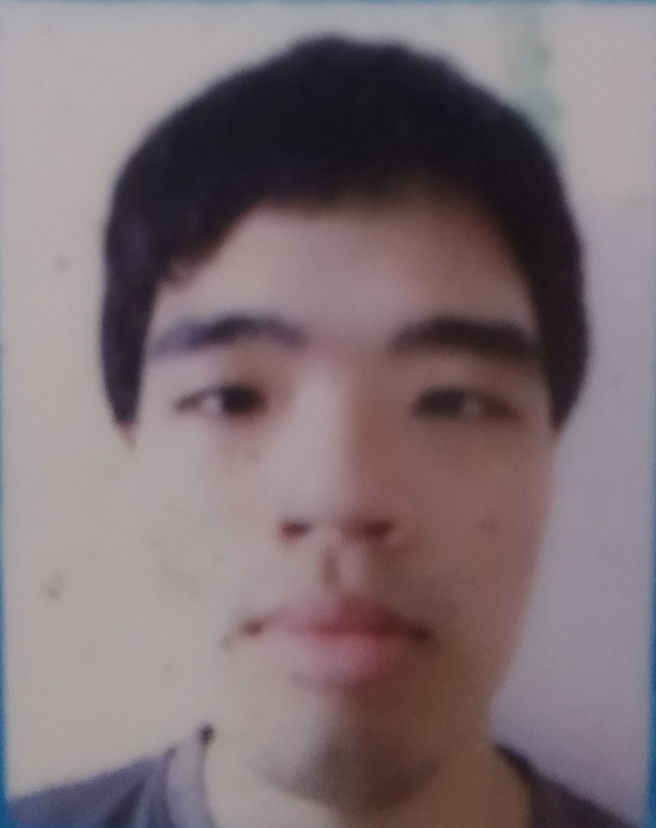

TOMOWORK GOAL SETTING WORKSHEET
NAME
Thaddeus Ho
INSTITUTE
Temasek Polytechnic
GOAL START DATE
20 MARCH 2023
GOAL COMPLETION DATE
1 JUNE 2023
MY CAREER GOAL IN 4 YEARS (By 2027)
WORK
I wish to find a full time job on LinkedIn that is related to engineering. I hope to be attached to an electrical company that will allow me to be sustainable to Singapore.
LEARNING
Sustainability, Data analytics and UL UX design
ACTIVITIES
I am interested to volunteer in PA system to manage the sound for religious organization in church. I would like to learn how to bake some cakes, pastries and bread
5 THINGS I WANT TO ACHIEVE FROM TAP (Please include more than 1 soft skills)
ACTION THAT WILL HELP ME TO REACH MY GOAL
REVIEW
(REVIEW BY 31 MAY MORNING)
1 | I hope to improve my resume writing by writing more formal English words to increase my chances of hiring.
2 | I hope to support my teammates through this programme and solve problems through design thinking as part of communication.
3 | I hope to have better understanding of companies through corporate visits in the next 1 to 2 months.
4 | I hope to achieve design skills and data using the design thinking concept process
5 | I hope to have a smooth sailing through TAP with good teamwork
1 | Select a detailed and chronological resume from Internet while following the workshop.
2 | Do not be alone all the time. Be more watchful by cheering people when they are upset.
3 | It would be good if I can do a background research about the company.
4 | Interview more users that are not from Tomowork. Sketch more products in 3D view.
5 | No backstabbing and vulgarities. Be more open-minded of what you say. Think first before speaking necessarily.
1
2
3
4
5
COMMENTS FROM FACILITATORS

